Slide 1


Introduction to Software Business Product Management
Week 2 Day 3
Led by: Emily Crose
for
Oakland University

Slide 2
Day 2 Recap

Slide 3

Questions From Day 2?

Slide 4
Terms To Listen For
Application Programming Interface (API)
Enables automated, programmatic retrieval of information using a standard framework.
Authentication
Refers to the process of verifying a user’s identity.
Rate-Limit
How many requests can occur at a given time.
Denial of Service
A forced outage of a service based on a misconfiguration or a concerted effort

Slide 5
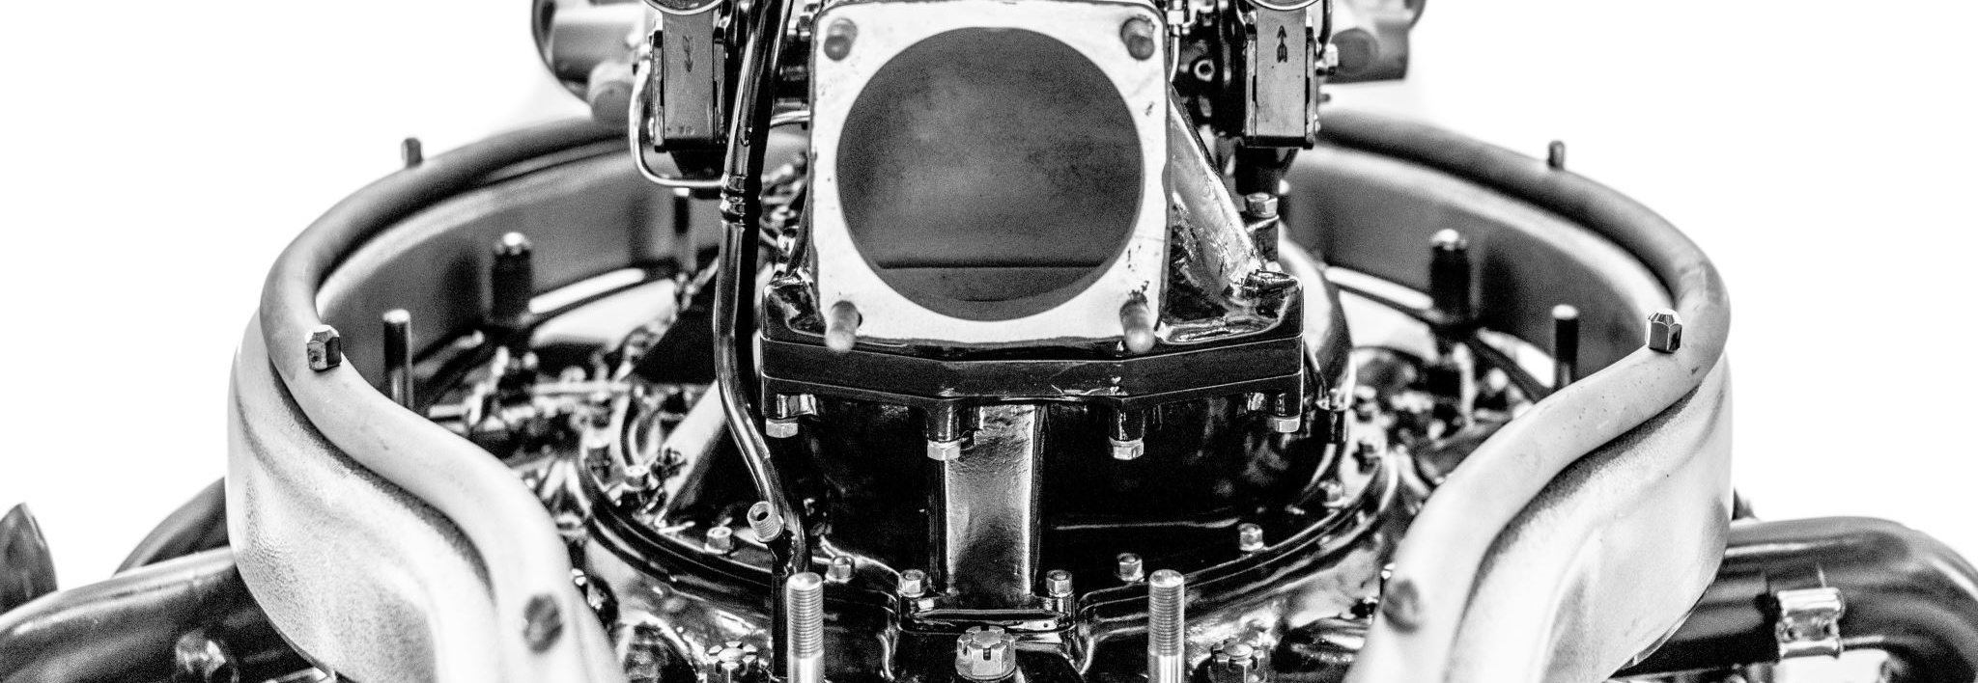

Purdue Model Explained

Slide 6
Purdue Model, What Is It?
A method of arranging and segmenting networked operational technology (OT) devices.

Slide 7
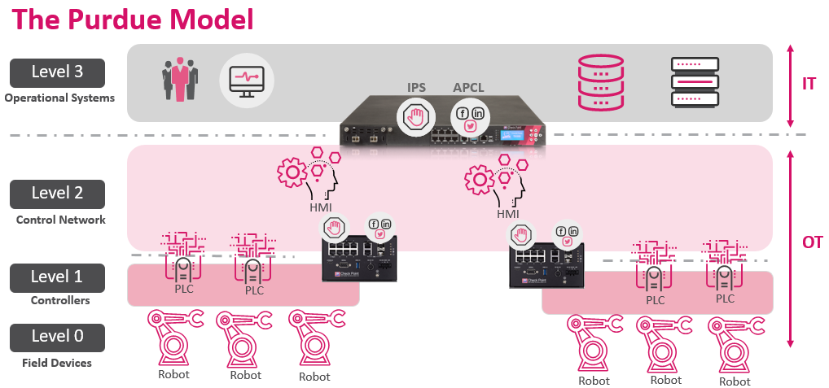

Slide 8
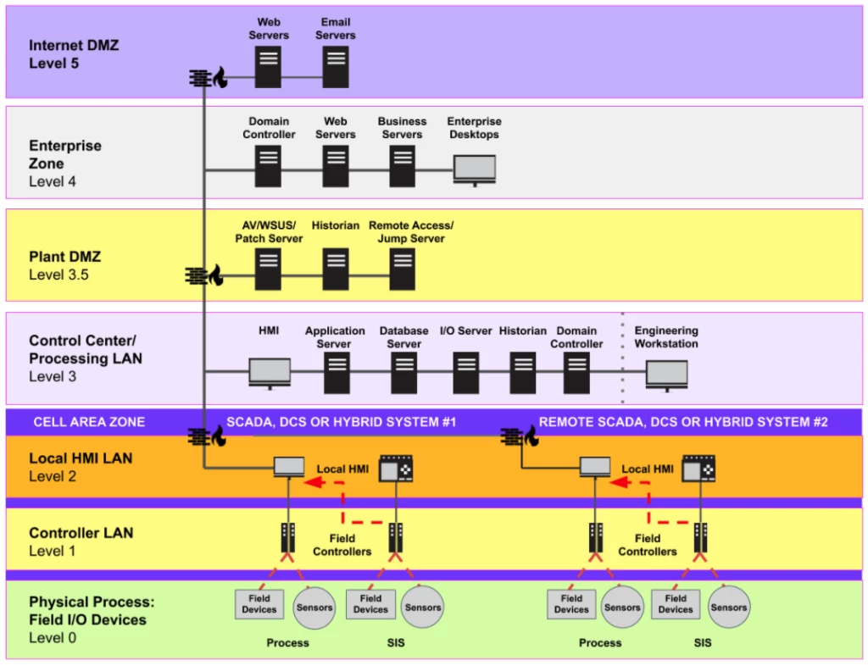

Slide 9
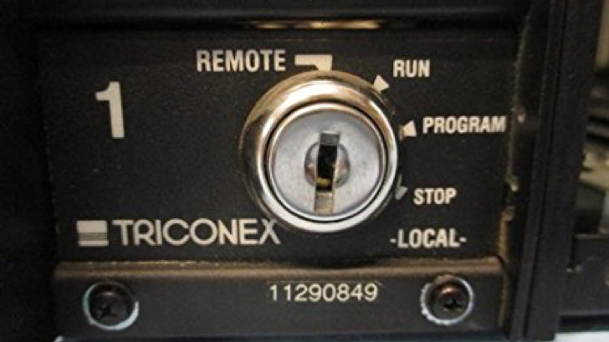
Anatomy Of A Complex OT Attack

Slide 10
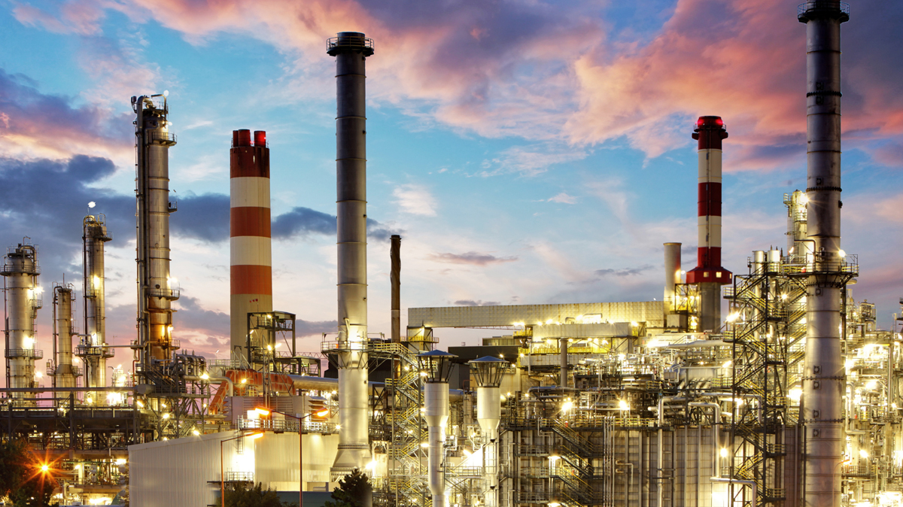

Slide 11
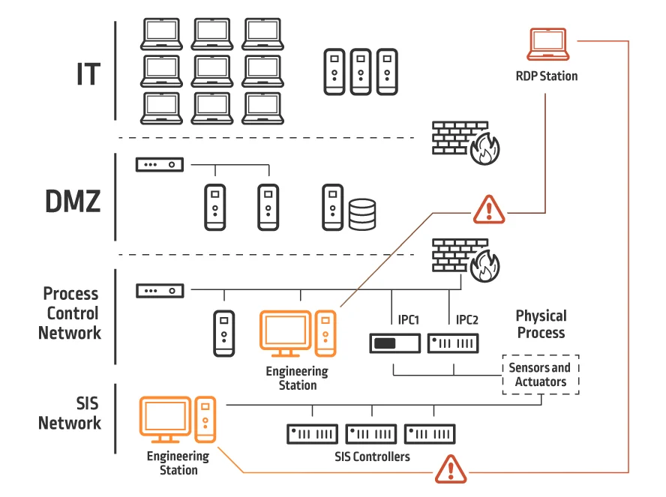
Inside The Victim Network

Slide 12


10 minute break

Slide 13
How Does Software Fit In?

Slide 14

Can This Apply To Cars?

Slide 15
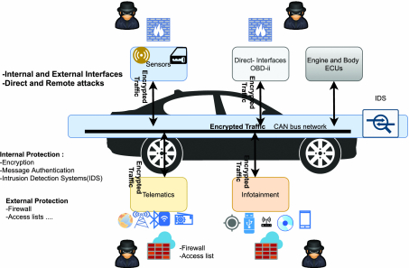
Controller Area Network
Notes:
CAN bus devices operate in an interconnected fashion, very similar to how we build computer networks. Controller devices produce information, and we transfer that information over a local area network that we call the CAN or Controller Area Network. That information is packaged in a way similar to the way we package network packets – we saw this last week.

Slide 16
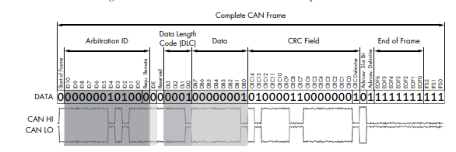
Notes:
This should look at least somewhat similar. The amount of information we’re talking about here is considerably less in CANbus traffic than it is in network packets. It has to be lean because we’re talking about controls that literally make the car move in real time. What you’ll notice about this frame is that there’s nothing here that provides any degree of security.

Slide 17
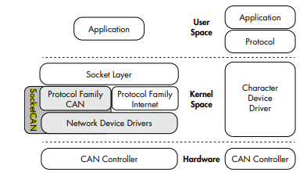
SocketCAN
Notes:
CAN = Controller Area Network
On the right is the CAN, on the left is socketCAN, a newer implementation of the CANbus

Slide 18

Where’s the Security??
Notes:
There’s very little security on the CANbus, but what security does exist is built into session establishment. The thinking is that we don’t necessarily need to build in security because historically, we could access the CANbus directly, and exclusively through an ODB-II reader. But now we have cars being added to wide area networks through a network connection, so there are more ways of accessing cars now.

Slide 19
Additional Protocols In Use
ISO-TP
A.K.A. ISO 15765-2
CANopen
GMLAN

Slide 20
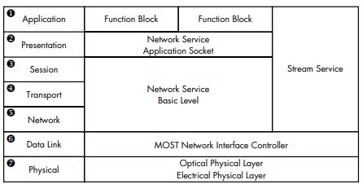
Vehicle Media Systems
Notes:
Vehicle media systems are a part of an interconnection of media devices we call MOST. MOST stands for Media Oriented Systems Transport.

Slide 21
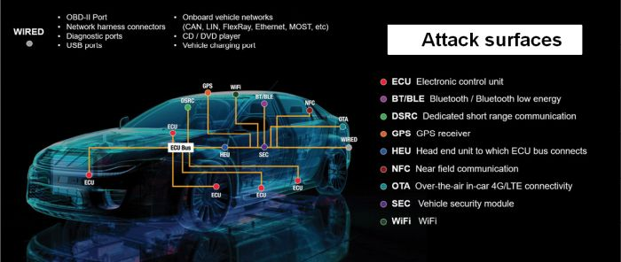
Car Software Attack Surface

Slide 22
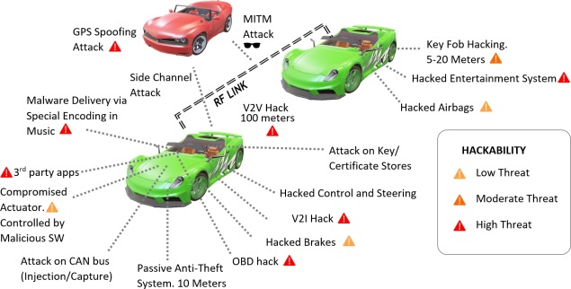
Popular Car Attack Surfaces

Slide 23

References
The Car Hackers Handbook: A Guide For The Penetration Tester by Craig Smith

Slide 24
Application Programming Interfaces (APIs)
What do they do for applications?
When would we want to use an API?

Slide 25
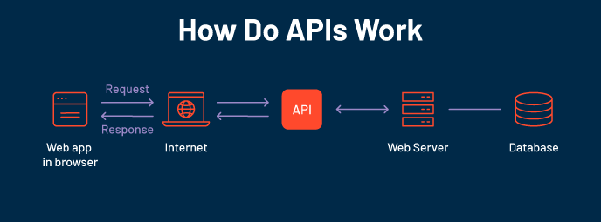

Slide 26
Familiar APIs
Representational State Transfer (REST or RESTful) API
Fast
Reliable
Widely adopted
Simple!
Simple Object Access Protocol (SOAP)
Used in some OT network appliances
Browser API
iOS/Android API
Allows developers the tools they need to utilize local resources in their own programs
Notification API calls
Camera activation
Media integration

Slide 27
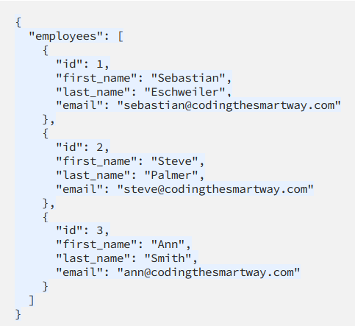
Notes:
Let’s take a look at a JSON form providing us information through an API interface. So when we use an API to retrieve information, we will typically be grabbing that information from a formatted file like a JSON file. We can see from this JSON file that actually this looks kind of like a database file.

Slide 28
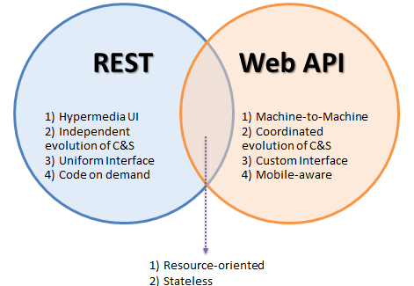
Popular API Frameworks

Slide 29
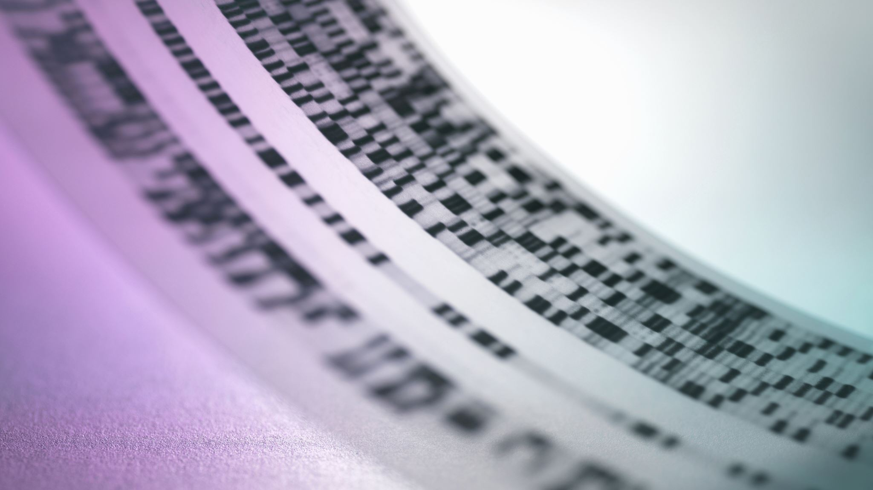
HTTP/Web API

Slide 30
HTTP API Verbs
HTTP
GET
POST
PUT
DELETE

Slide 31
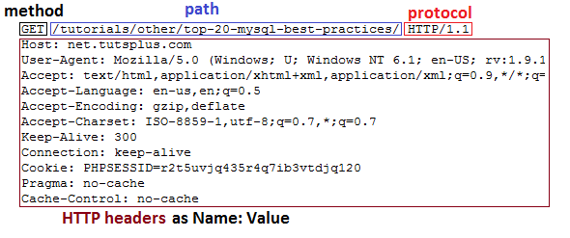
HTTP GET Header

Slide 32
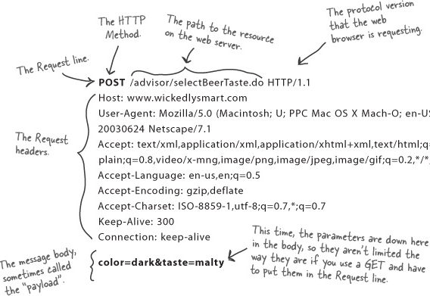
HTTP POST Header

Slide 33
Weather API Documentation
https://rapidapi.com/weatherapi/api/weatherapi-com
Notes:
A word on documentation – we should always start with the documentation when we go to program with an API

Slide 34
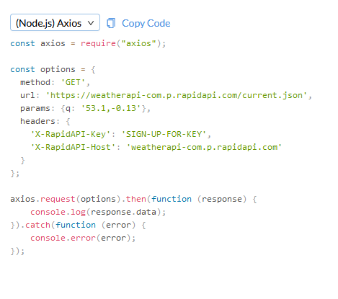
Notes:
So let’s take a look at what an API actually looks like in practice.

Slide 35
Working With APIs
Can be programmed
Can be used in a raw request

Slide 36
Programming Mobile Apps w/APIs
Android
Kotlin
Apple iOS
SWIFT
Both have access to device APIs!

Slide 37
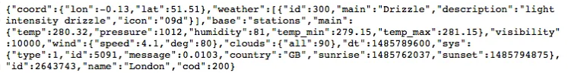
Mobile Device API Example

Slide 38
10 minute break

Slide 39
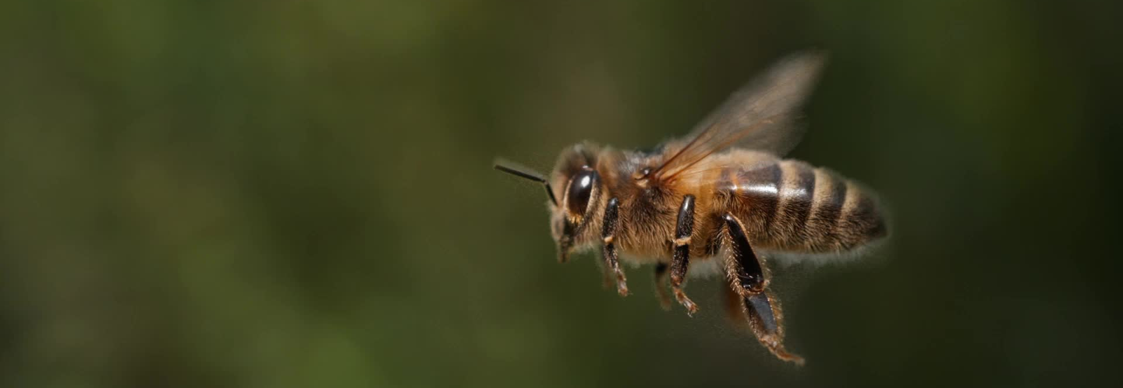
Securing APIs

Slide 40
SAML vs. Oauth
Security Assertion Markup Language (SAML)
Windows uses this for Single Sign On (SSO)
Integrates with Windows domain
Optimized for enterprise security
Oauth
Optimized for mobile applications
Uses API calls itself!
Tends to play better with mobile & lightweight IoT environments

Slide 41

What is Oauth?

Slide 42
Oauth
Allows one application to validate itself with another application
Uses tokens for authentication
We give applications permission to play with other applications via Oauth
Think of it like a valet for your apps!

Slide 43
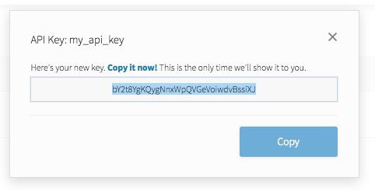
API Key
Notes:
API keys are meant to be kept secret. Why? Because they include information related to one specific account.

Slide 44

Why Do We Need API Keys?
Account verification
Who is requesting what information?
Rate limiting
Avoid denial of service
Permissions
What do we want to allow certain people to see?

Slide 45
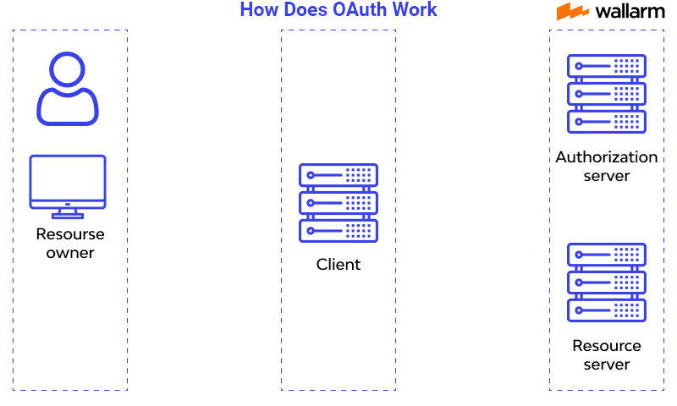
How does OAuth work?

Slide 46
Let’s Make A Github Account!
https://github.com

Slide 47

Software Development: The Lifecycle

Slide 48
What is the Software Development Life Cycle?
The SDLC helps us organize the process of building software
Includes steps for building, revising, and deploying software
Includes roles associated with each step along the building process

Slide 49
Why Do We Need An SDLC?
Notes:
We’ve spent two full weeks talking about how software functions, how software can go wrong, and some about how we build software. So by now, it should be obvious that software development is a fairly complicated subject. What we need is a notional concept to fit all of the components of software development into if for no other reason than organization.
For each of the functions of the process of building software, we will have multiple groups with multiple people all working together to create functional applications. This means we have a lot of moving human parts which can be challenging to successfully navigate without a common understanding.

Slide 50
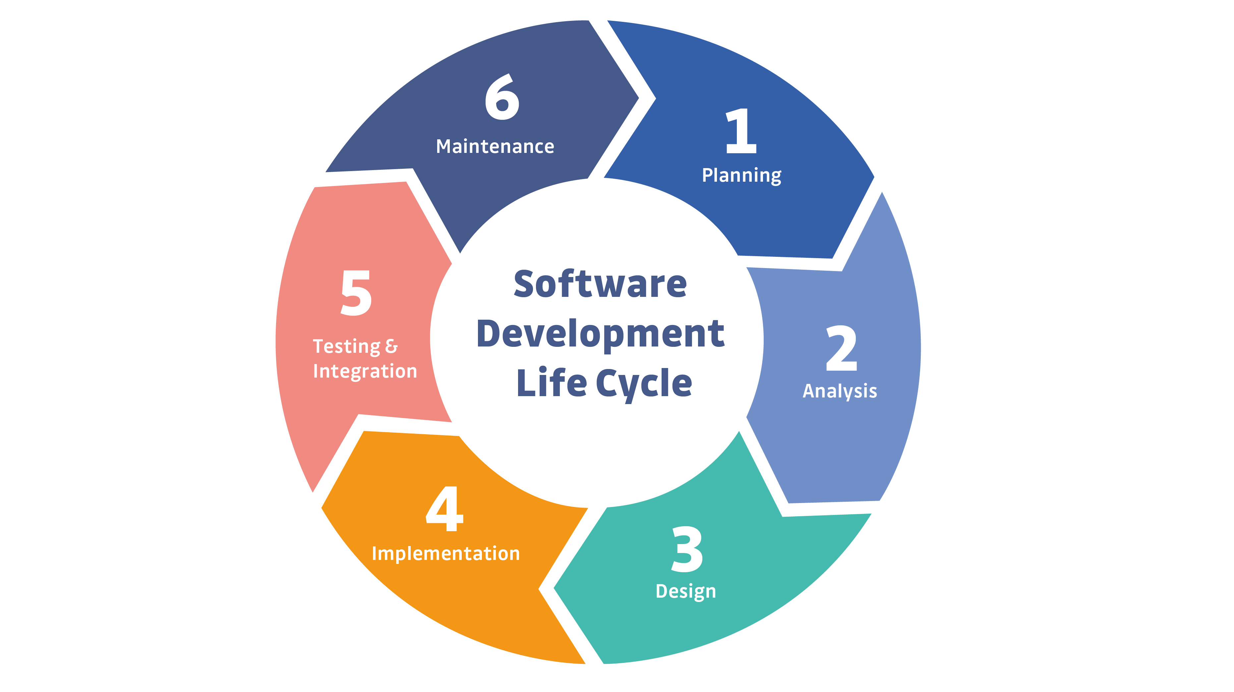
Notes:
This is a simple example of the SDLC. Typically, representations of the SDLC will have around 6 steps, but the steps will generally match what you see here.

Slide 51

More To Come on the SDLC Next Time!

Slide 52

Question or clarifications?

Slide 53

Review Day 3

Slide 54

Preview Week 3

